Slide 2
Thank you for attending NIWeek 2017.
Notes:
As a speaker of NIWeek, begin your session by welcoming attendees.
Convey these points:
Your time is valuable, thank you for being at NIWeek 2017.
We aim to make this as valuable as possible, from sharing best practices to helping connect you to fellow engineers and NI experts.

Slide 4
Notes:
Update the color palette to map the old template
Check text box

Slide 5
A software-centric platform that accelerates the development and increases the productivity of test, measurement, and control systems.
Notes:
Our approach is to accelerate productivity, innovation, and discovery through a software-centric platform for developing any system that needs test, measurement, and control.
When spending time and energy making technology work gets in the way of focusing on a solution, we know that’s a big problem. So, our goal is to enable engineers to get their job done faster regardless of their application or industry.

Slide 6


Tim Vargo
Ravi Beniwal
Exceptional service in the national interest
Sandia National Laboratories is a multimission laboratory managed and operated by National Technology and Engineering Solutions of Sandia, LLC., a wholly owned subsidiary of Honeywell International, Inc., for the U.S. Department of Energy’s National Nuclear Security Administration under contract DE-NA0003525.
Instrumentation Engineer
tdvargo@sandia.gov
Owner
ravi@binarypalette.com

Slide 7
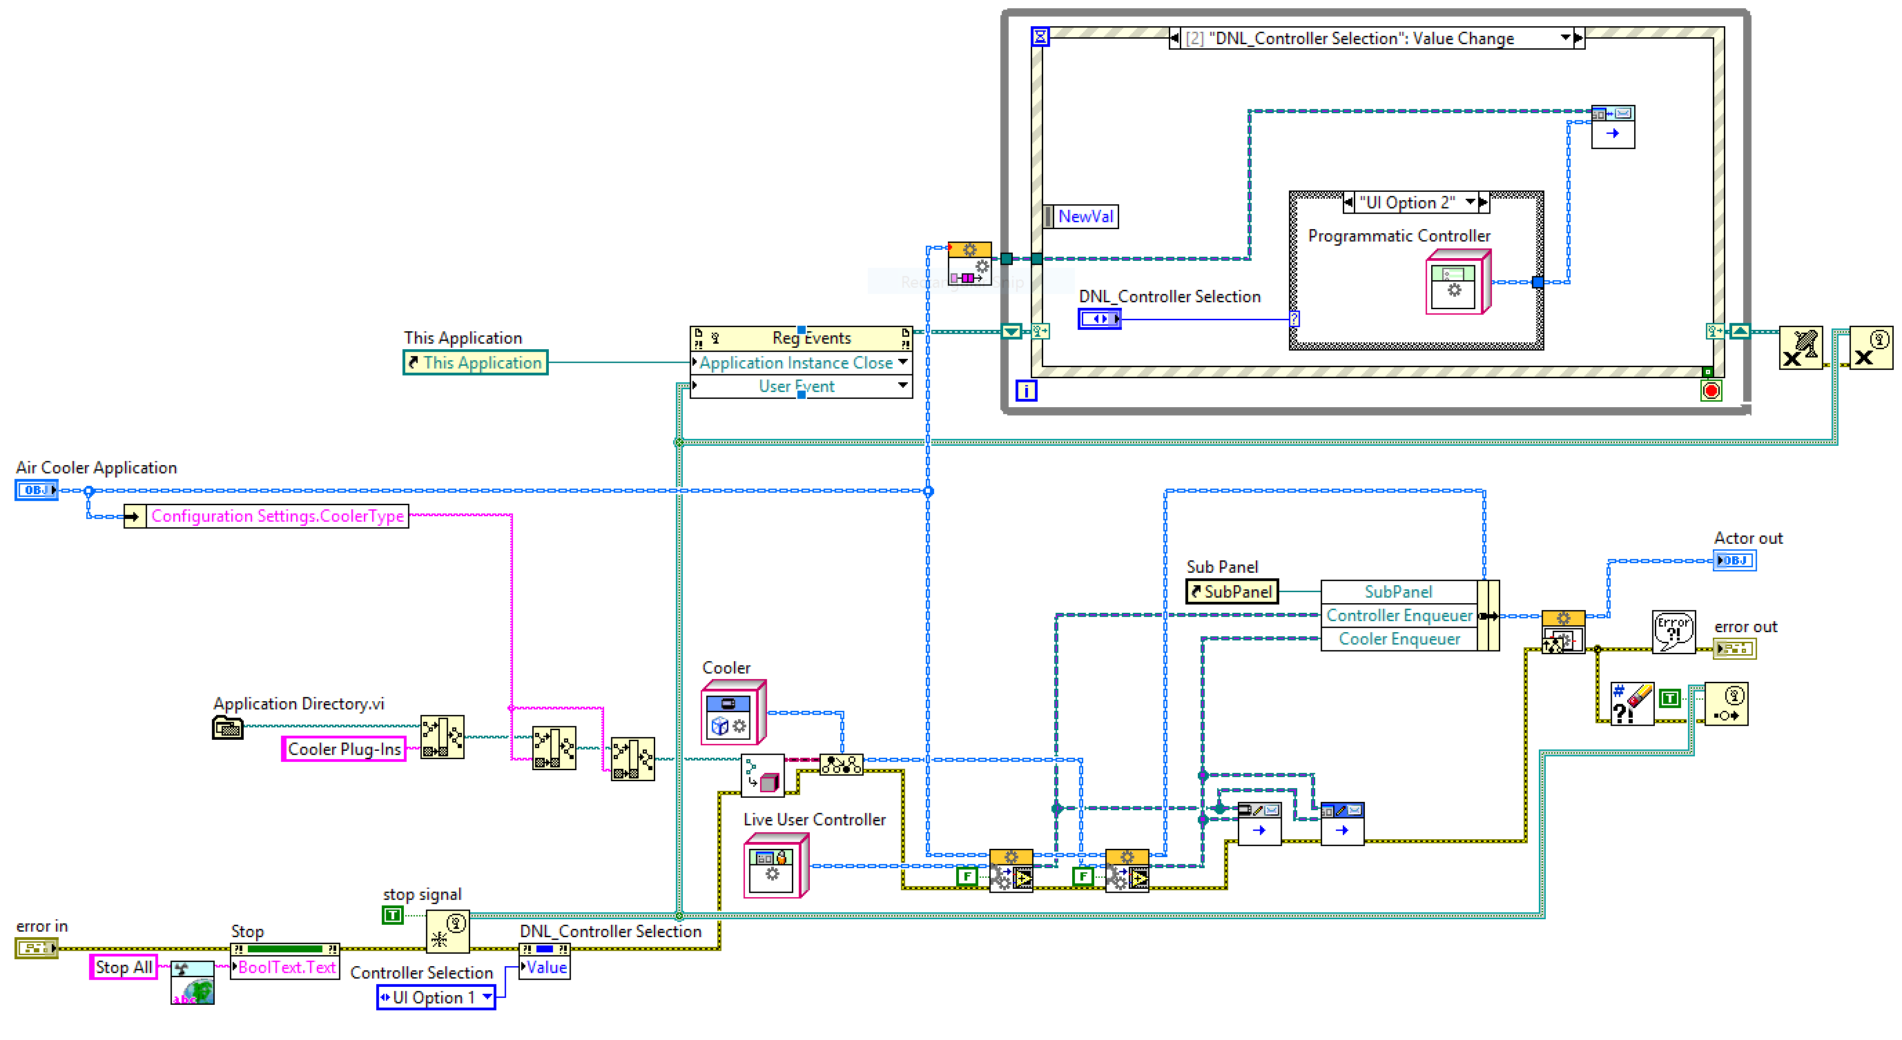
As LabVIEW enthusiasts, we all love visuals
Nicely laid out block diagrams, happily flowing data and messages, …

Slide 8
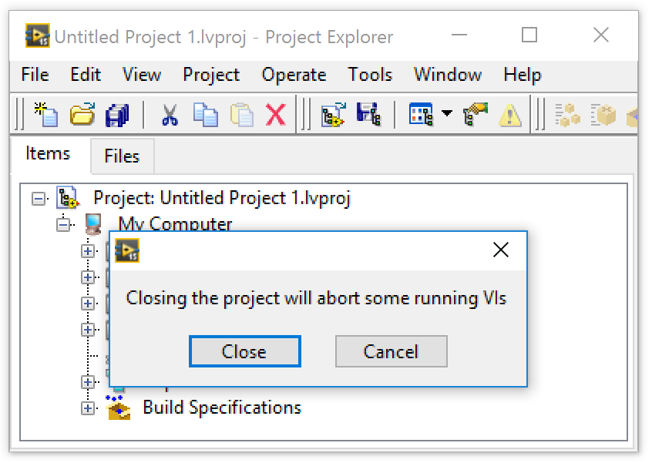
But There Are Visuals That Make Our Faces Cringe
… and our sphincters tighten
WHAT?!
There are still VIs running?! Which ones?!
I thought, I got ‘em all ☹

Slide 9
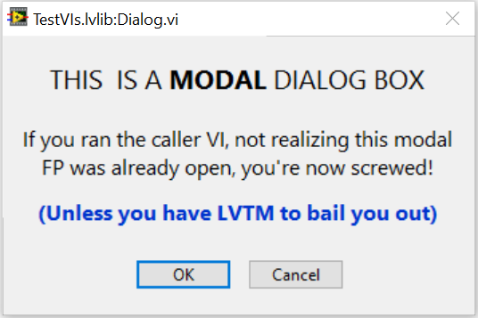
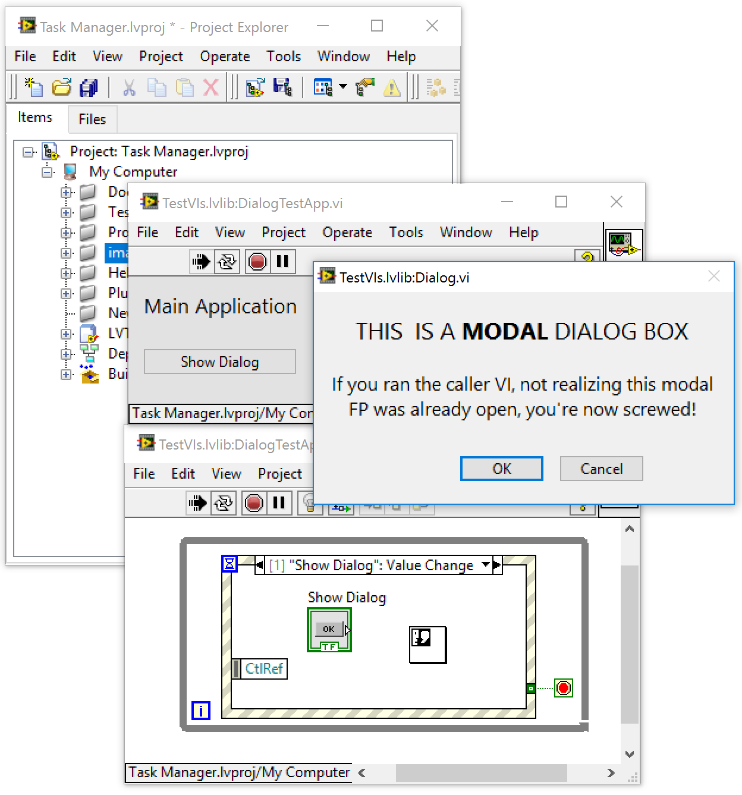
And then there is the stale·mate
/ˈstālˌmāt/, noun, a position counting as a draw, in which a player is not in check but cannot move except into check.
These buttons only laugh at you when clicked
<sigh> I guess the only way out of this is to kill LabVIEW – but I have unsaved VIs! #%$!@#$

Slide 10
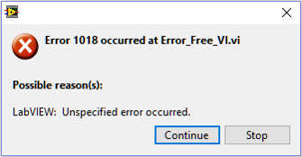
Random VIs Throwing Random Errors
… and no easy way to get to them
Oh THAT’s helpful!

Slide 11



Tried & True, Conventional Debugging Tools
… which still work very well, but with limitations
Built-in Debug Tool | Pros | Cons
Execution Highlighting | Visualizes data flow | Slows execution speed (impedes discovery of timing problems)
Single Stepping | One operation at a time | Slows execution speed (impedes discovery of timing problems)
Breakpoints | Pause execution at this exact point (useful for beginning execution highlighting and single stepping) | Persistent (must remember to remove them before deployment)
Notes:
Persistence is both a Pro and a Con

Slide 12


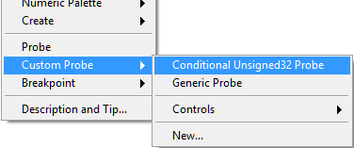
Probes !!!
Generic (default) Probes
Retain Wire Values
Custom Probes
Custom Probes Conditional (native)
Custom Probes Controls (look Mom, no code!)
Custom Probes New… (roll your own)
An awesome suite of custom probes
by Saphir, 3rd party, Free, ViBox – Probes
Variant Probe
Courtesy of LAVA member Ton Plomp
Notes:
Retain Wire Values keeps wire values in memory so that a probe placed AFTER running the VI can still view the value!
Also enables hovering over any wire to glimpse its value.
Saphir probes are available for free download on the LabVIEW Tools Network
Variant Probe is available for free download from LAVAg.org

Slide 13
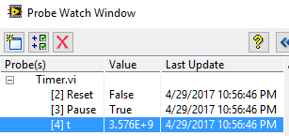
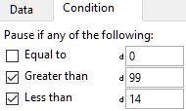

Tried & True, Conventional Debugging Tools
… which still work very well, but with limitations
Built-in Debug Tool | Pros | Cons
Default Probes | Peek at wire values throughout execution | Difficult to place in clones, Non-persistent
Conditional Probes | + “pause if value” logic | + Not available for all datatypes
Custom Probes | + custom view and/or actions | + Per LabVIEW version
Notes:
Probes are commonly called "Watchpoints" in other languages
Conditional Probes are commonly called "Watch Variables" in other languages
Persistence is both a Pro and a Con

Slide 14
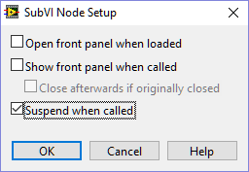

Often forgotten, overlooked
or just plain ol’ “huh, I-never-knew-about-that”
Suspend when called
Access this from “SubVI Node Setup”
Suspends a subVI when called and waits for user interaction
Allows changes to input values, then re-execute
Allows changing the output, then return to caller
A poor-man’s (yet extremely effective) unit testing
Video Demo: https://youtu.be/AgXcyf2Ta_A

Slide 15



There are many Free, 3rd-party Debugging Tools
These will retain information even if LabVIEW crashes!
WinDebugLogging
Write debug strings to the Windows debug interface
Dr. Damien (DFGray), Nov-2008
DebugView (from Sysinternals [Microsoft])
WinDebugLogProbe
Tim Vargo
Notes:
Using the Windows debug interface retains information even if LabVIEW crashes!
Also works for deployed executables, and has very low overhead
View the results with DebugView by Sysinternals [now Microsoft]

Slide 16
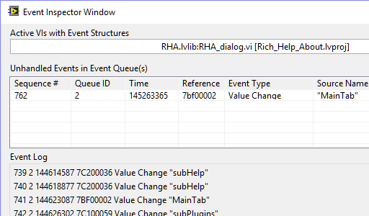
More NI debugging tools
Built-in to LabVIEW
Event Inspector
Introduced with LabVIEW 2013
Gains new understandings into the inner workings of our event structures

Slide 17
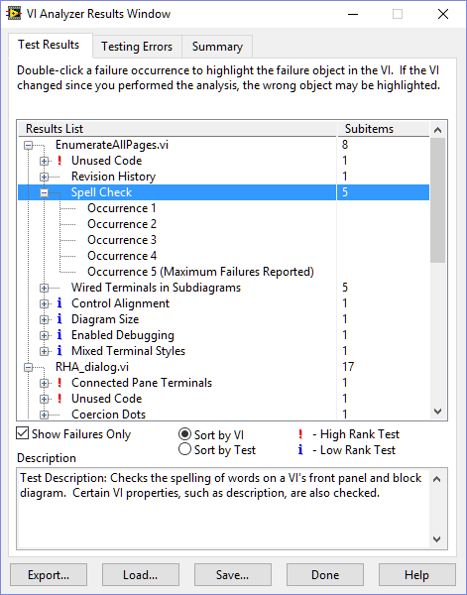
More NI debugging tools
Toolkits for extra cost (but worth it, IMHO)
VI Analyzer
VI Analyzer does its job well, but it intends to perform a static analysis of VIs, not a dynamic analysis of code while running

Slide 18

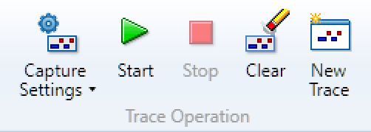
More NI debugging tools
Toolkits for extra cost (but worth it, IMHO)
Desktop Execution Trace Toolkit (DETT)
The DETT product is very good at what it was designed to do
dynamic execution traces provide a fantastic wealth of evidence when event timing and/or sequence information is critical
… but they don’t provide non-event related information, such as state

Slide 19
Some impediments to advanced troubleshooting …
All of these built-in tools are extremely useful during troubleshooting of individual VIs or small collections of VIs
particularly when we already know which VIs are the troublesome ones
The LabVIEW IDE still lacks a debugging tool to provide insights with a "bigger picture" view of an entire project

Slide 20
Some impediments to advanced troubleshooting …
Using only the native troubleshooting tools
reentrant VIs are especially difficult to debug, since each preallocated clone will have its own data space in memory
shared clones can be even more complex, since they may or may not share a common data space
Dynamically launched VIs, even if not reentrant, present their own particular frustrations while debugging, since it is difficult to place probes BEFORE executing the code.

Slide 21
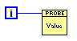
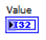
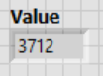
Placing probes BEFORE executing CBR VIs …
Simply place a probe in the reentrant master, right?
No! Clones will not get probes
Create on ordinary VI with a single control of that type
place it
wire it
watch its FP
NOT a probe, but rather a workaround
Will appear in ALL clones of its caller (a true probe would not)

Slide 22
Placing probes BEFORE executing CBR VIs …
Right-click on SubVI, select SubVI Node Setup >> Show front panel when called
Just for this call
VI Properties >> Window Appearance >> Customize >> Show front panel when called
All calls
Problems:
Persistent
Interrupts execution

Slide 23
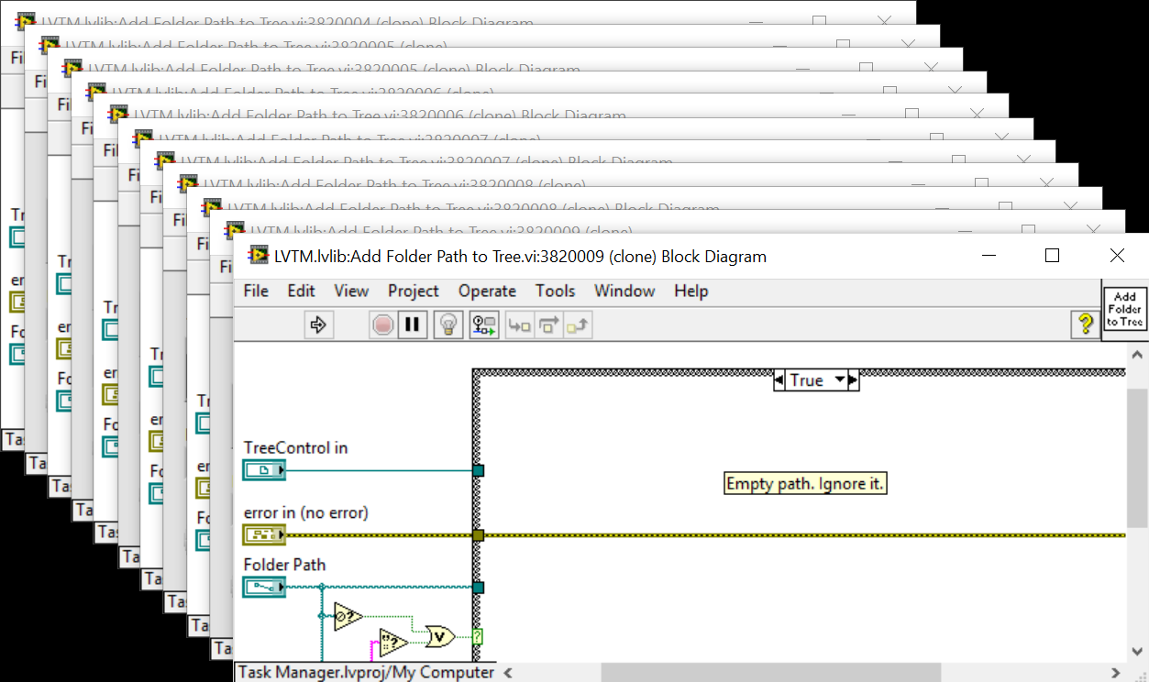
Placing probes BEFORE executing CBR VIs …
Place a breakpoint in the reentrant master. Awesome: all clones will also get breakpoints, opening their FPs & BDs
Problem: all clones will also get breakpoints, opening their FPs & BDs!

Slide 24

What to do when debugging becomes too complex ???
How to defeat these shortcomings, and many other debugging related challenges …
have long been the topics of many user community discussions
several ad-hoc solutions and processes, usually quite limited in scope, have been developed over the years by the user community
but they lack the coherence of a unified tool
Introducing the

Slide 25

LabVIEW Task Manager
The LabVIEW Task Manager seeks to be that missing unified debugging tool
Providing a dynamic & big-picture view of all VIs currently in memory
by delivering new comprehensions into your running code
Conquering those difficulties concerning reentrancy, clones, dynamic launching, finding & aborting hung VIs, and other sticky complications
by enabling interaction with individual or groups of VIs in many various ways

Slide 26
Application Instance
The LabVIEW Task Manager (LVTM) detects all open LabVIEW application instances, but discovers and displays VIs for only the selected instance

Slide 27
Menu: View
The View menu provides options to set an update speed for refreshing the view and a few view options

Slide 28
Menu: View>>Group By Library
Group By Library displays all VIs in the selected application instance grouped by the library they belong to. All VIs that are not part of any library are shown under <no parent library>.

Slide 29
Menu: View>>Group By Folder
Group By Folder displays all VIs in the selected application instance with their folder hierarchy on disk. This view makes it easy to see where all the project dependencies live on disk.
Notes:
It is in this view where items can be excluded from being displayed, which we will see in a few slides later.

Slide 30
Menu: View>>Flat List
Flat List displays all VIs in the selected application instance as a list. This view can help sorting the view by different properties of the VIs, by clicking on the column headers.
Notes:
In particular, sorting the flat list view by State will help distinguish between Idle, Running, and RunTop (top-level) VIs; which can be very useful when looking for VIs that are still running that you thought should not be. VIs with a State of RunTop can then be aborted!

Slide 31
Menu: Filters
The Filters menu items provide several settings for filtering out items from view
Filtering out VIs that you don’t currently care about can tremendously improve performance of the LVTM
Certain dynamic properties of all VIs are occasionally checked and updated. The more VIs that need to be checked, the more resources are tied up, and the longer each update cycle takes.
Also helps the user to de-clutter the view

Slide 32
Menu: Filters>>Extensions
Select (√) the file extensions that you want to filter out of the view. All files with the selected extensions will be ignored.

Slide 33
Menu: Filters>>Types
Select (√) the VI types that you want to filter out of the view. All VIs of the selected type will be ignored.

Slide 34

Shortcut Menu: Filter Out …
While in the Group By Folder view, right click any folder and select Filter Out This Folder, adding that folder to an exclusion list
Or you can select Filter Out All But This Folder, which will add all remaining folders to the exclusion list
Any VIs in these filtered out folders will no longer show up in the tree
Although filtered paths can only be added or removed while in the Group By Folder view, the hidden paths will also persist in other views. This helps the user to de-clutter the view, and can also greatly improve performance.

Slide 35
Menu: Filters>>Paths
If one or more paths have been filtered out, they will show up under the Filters>>Paths menu. Clicking any of these paths will remove it from the exclusion list.
Selecting Remove All will remove all filtered out paths, effectively disabling path based filtering.

Slide 36
Progress Update
Any time changes are made to the filters or to the view, the view is refreshed
A progress bar, in the status bar at bottom right, shows the discovery and update progress

Slide 37
Toolbar
LVTM provides several operations that can be performed on one or more selected VIs in the tree. These operations may be invoked from the toolbar buttons near the top of the screen.
These same operations may also be invoked from the right click shortcut menu.
Open Front Panel(s)
Close Front Panel(s)
Open Block Diagram(s)
Close Block Diagram(s)
Highlight Execution(s)
Do Not Highlight Execution(s)
Pause Execution(s)
Resume Execution(s)
Toggle Execution(s)
Abort VI(s)

Slide 38

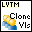
Helper Functions
Available from the Functions Palette
These functions are available to assist with your debugging efforts
LVTM Pause – Drop this function into any VI you wish to pause
If the pause request is generated from a clone of a reentrant VI, it will pause all clones of that VI
Works only if the LabVIEW Task Manager is running, in the same application instance
Clone Beacon – Drop this VI into any asynchronously called reentrant VI, to force it to be seen by LabVIEW Task Manager
Notes:
If the pause request is generated from a clone of a reentrant VI, it will pause all clones of that VI

Slide 39
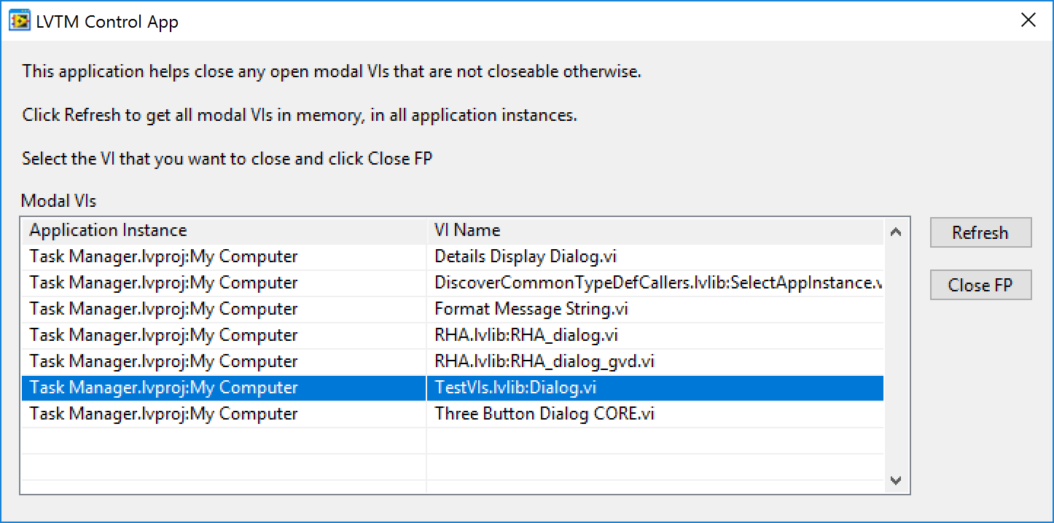
LVTM Control App
Remember the stalemate?
This is an executable that works with LabVIEW Task Manager
It queries LVTM for all modal Vis, in all application instances
Let’s you close the FP of any of these VIs

Slide 40
And now for the
LIVE DEMO
!!!!!!!!!!!!!!!!!!!!!!!

Slide 41
Demo Agenda
…\examples\Industry Applications\Temperature Monitoring\Temperature Monitoring.lvproj
Demonstrate what the LVTM shows when a couple of (async?) processes didn’t properly shut down after the main application shut down. Unfortunately, these process refuse to abort, so continue looking for a different example that would.
…\Test VIs_LVTM\Parallel VIs Launcher.vi
Demonstrate normal VI –vs- different kinds of clone VIs
…\Test VIs_LVTM\DialogTestApp.vi
Demonstrate remotely closing a modal front panel, which has caused all LabVIEW application instances (including LVTM) to hang.
???
Demonstrate {goal}
???
Demonstrate {goal}
???
Demonstrate {goal}

Slide 42

How to GET the tool …
https://lavag.org/files/file/245-labview-task-manager
How to CONTRIBUTE to the tool …
https://bitbucket.org/lavag/labview-task-manager

Slide 43
QUESTIONS?

Slide 44

We must avoid “drawing vast conclusions from half-vast data”
— Jerry R. Ehman, SETI Astronomer

Slide 45
Notes:
We want your feedback. Please take one minute to complete the session survey.

Slide 47
Notes:
Convey these points:
Thank you for attending NIWeek 2017.
There’s many ways to stay connected.
You can download the session materials through the mobile app or at ni.com/niweekcommunity.
If you’re interested, you can reach me at [share your email]

